Slide 1
Business SPOC Update
Supt. Patrick Holdaway

Slide 2











































Digital Evidence Management Systems (DEMS)
3
9
2
1
5
11
7
4
12
10
6
8
21
25
23
13
20
22
31
18
19
27
14
17
24
32
 | NICE Investigate
 | Axon Evidence
 | Aetopia
 | SentrySIS
 | To be agreed
26
36
29
28
16
15
43
38
39
37
41
33
40
30
42
34
35
Correct as of 20/02/23

Slide 3
Are you PROTECTED?

Slide 4
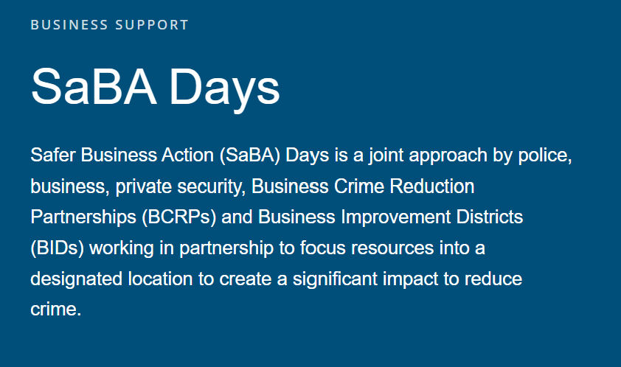
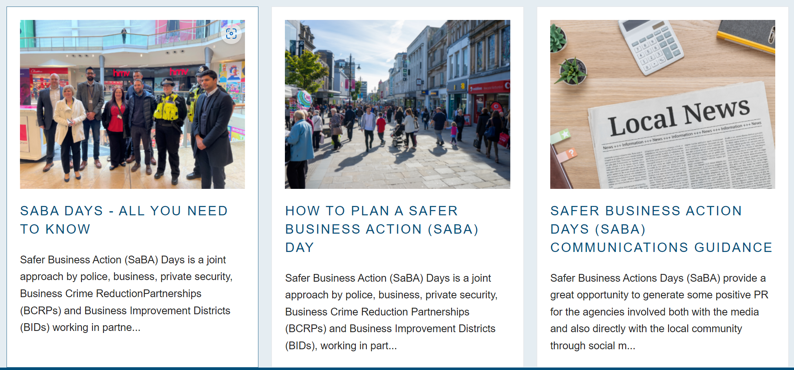

Safer Business Action Days & Week of action
SaBA Days (nbcc.police.uk)
Week of action – 16th October 2023

Slide 5
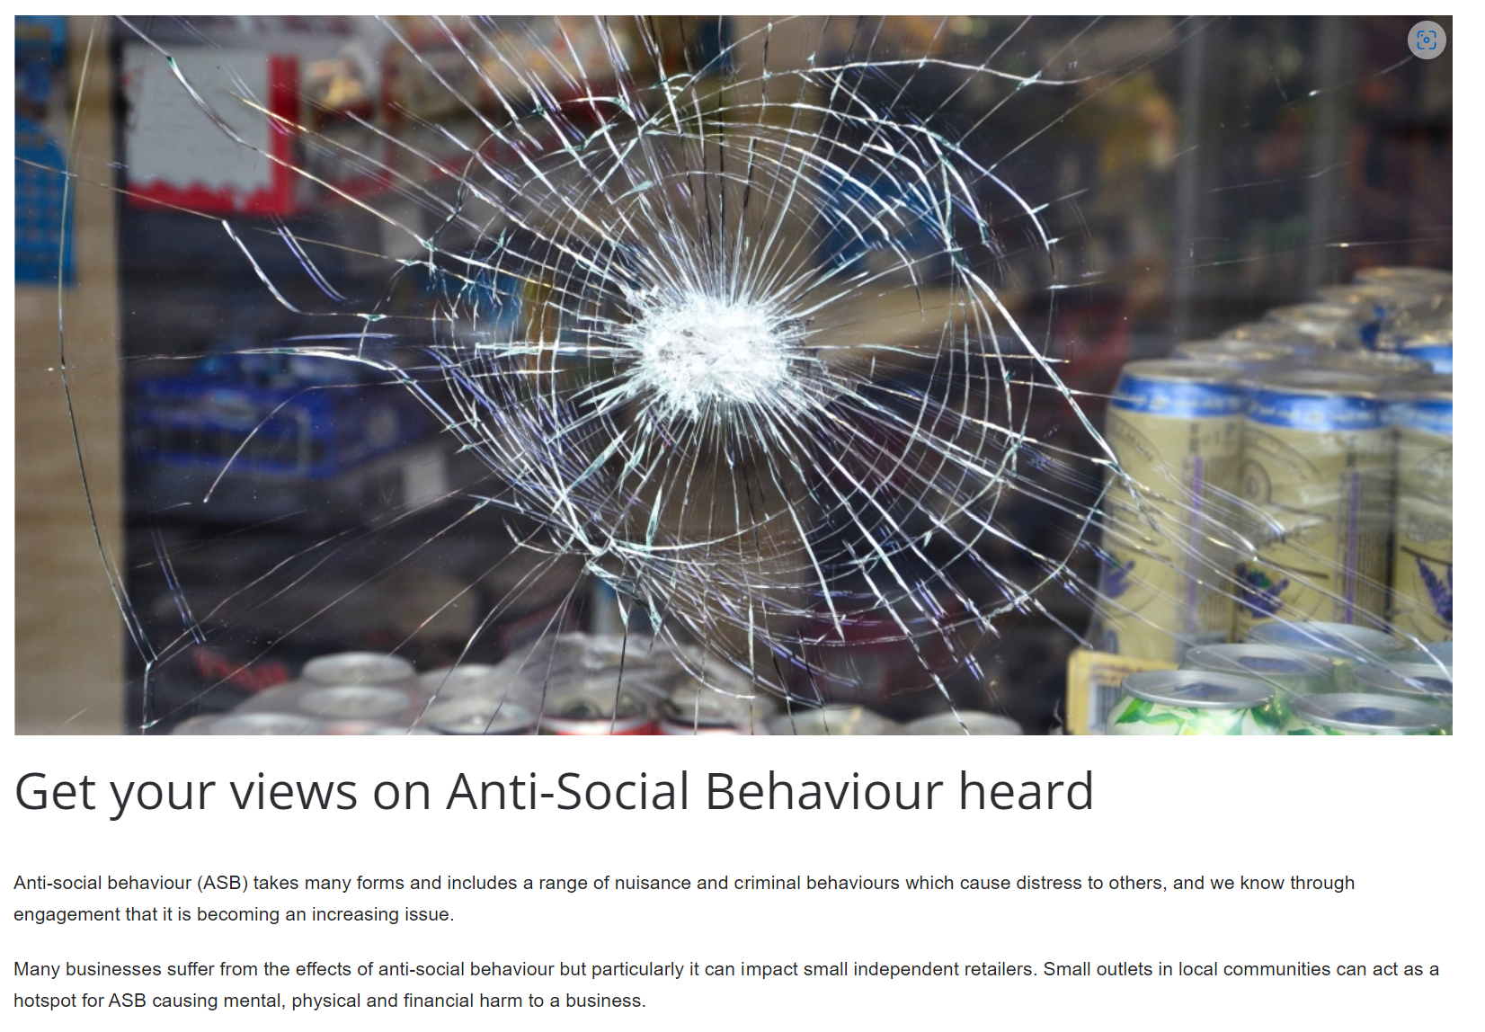
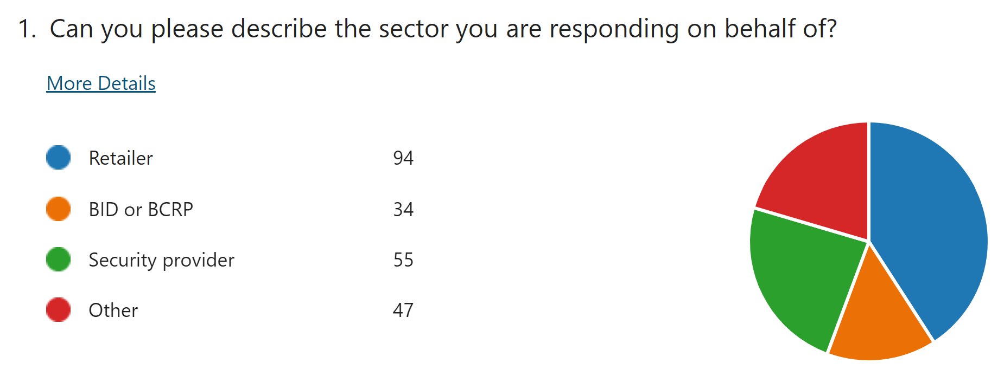
ASB – a business context
Survey
CBOs (SOC pilot)
CPNs & CPWs – BID/BCRP ownership
Banning procedures
CSAS
Community trigger
ASB section on website

Slide 6

BCRPs & Accreditation
332 BIDS
10 new BIDs in the last year
53 in development
121,485 businesses
£144,735,669 generated
85 ballots in last 12 months, only 5 failed
Source: British BIDS Annual Survey 2022

Slide 7

Offender2Rehab
https://www.westmidlands-pcc.gov.uk/offender-to-rehab/

Slide 8
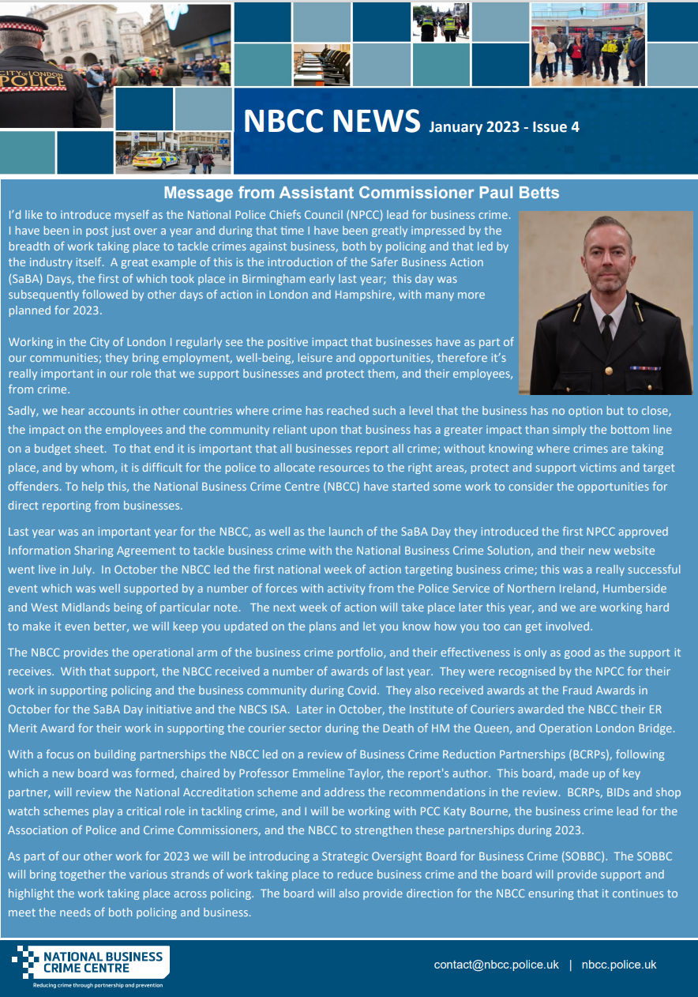
NBCC Newsletters
Opinion
Good news stories
Focus on a force
PCC engagement

Slide 9
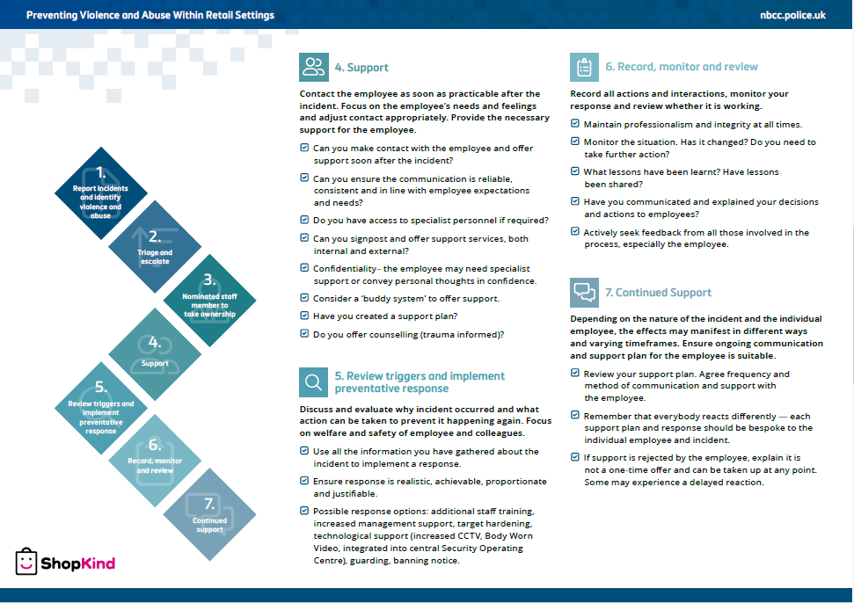
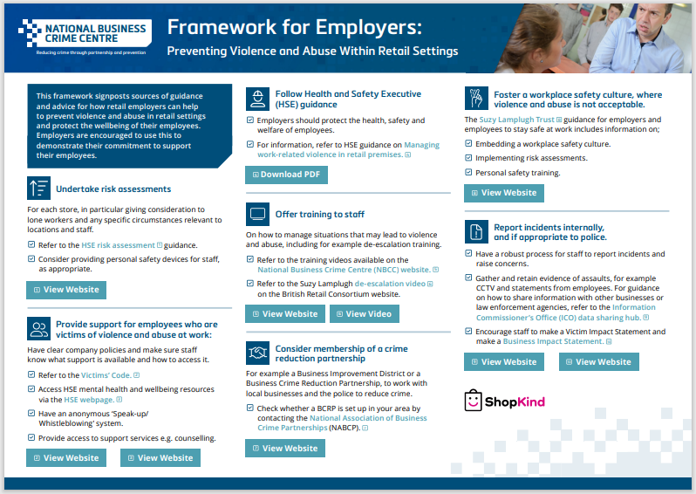
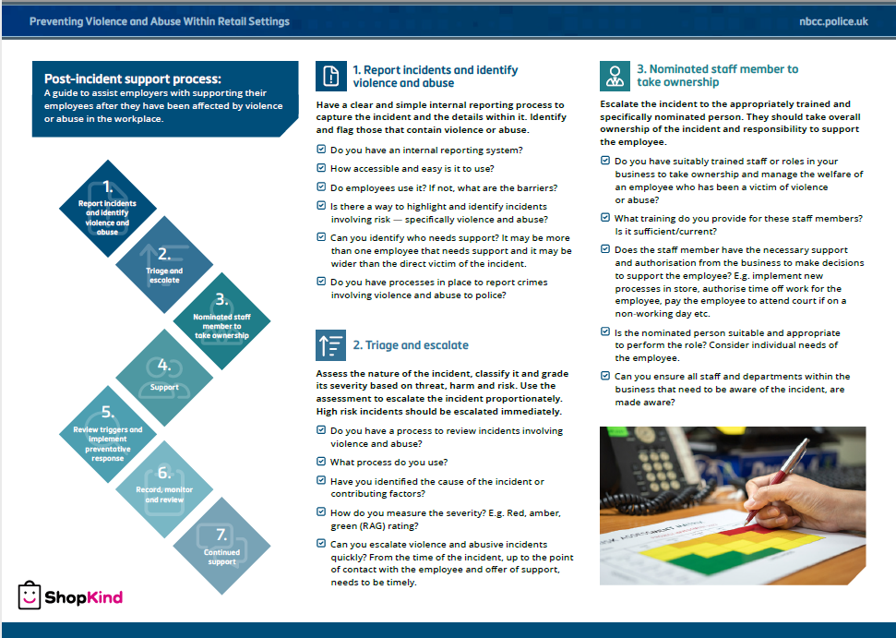

Slide 10

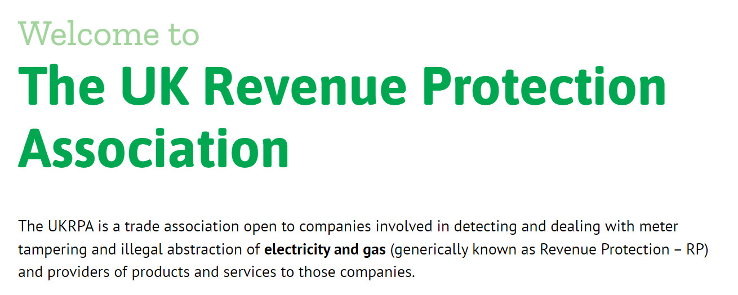
Theft of energy

Slide 11
